Slide 1

Application: Food Express Type: Application Architecture View: Logical View Style: Layered Architecture Pattern
Users
Delivery Channels
Core Business Processes
Data And Information
Technology Enablers
Search
Search for Restaurant/Food item
For Database
Customer
Order
Placing an Order
Connection for MySQL
Mobile App
Food Retailer
Location API (Google Map)
Payments
Payment Information
User Interface(React Native)
Distributor
Browser
User Account
User Account Information
AWS lambda for API
Advertisement
Advertisements Information
CI/CD GitHub
Administrator

Slide 2
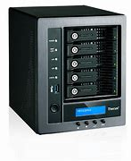








Food Express Application
Architecture type : Application Architecture
View : Process View
Style : Client – Server Architecture Pattern
Admin
Storage
Exception
handling
Internet
Mobile Devices
Users
https
https
Browser
DB Server
App Server

